Slide 1

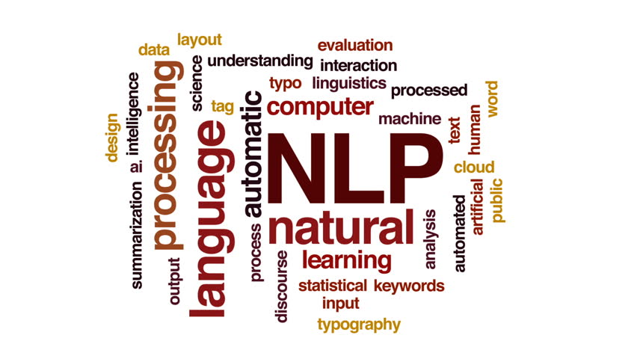
A Walk Through NLP

Slide 2
What is Natural Language?
Please reply at : http://bit.ly/NLP_poll
Results: http://bit.ly/NL_poll_results

Slide 3
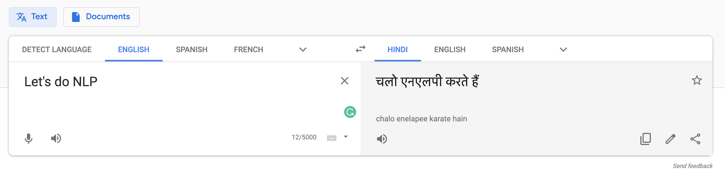
Applications of NLP
MACHINE TRANSLATION

Slide 4
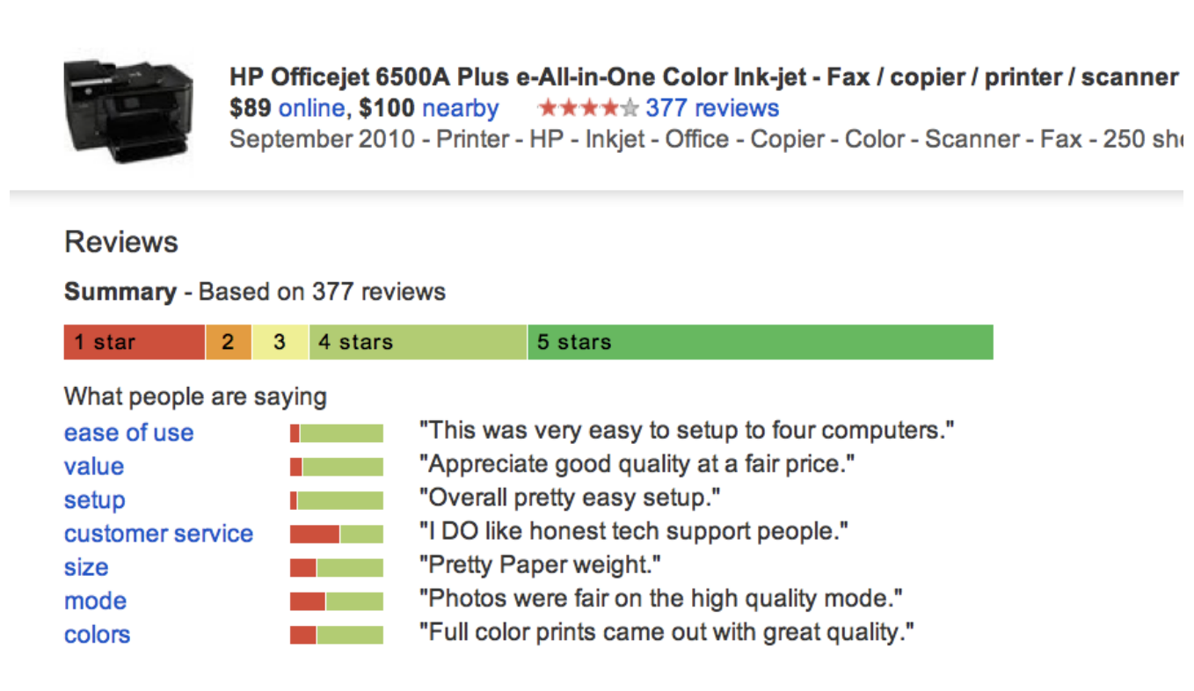
Applications of NLP
Information & Sentiment Analysis

Slide 5

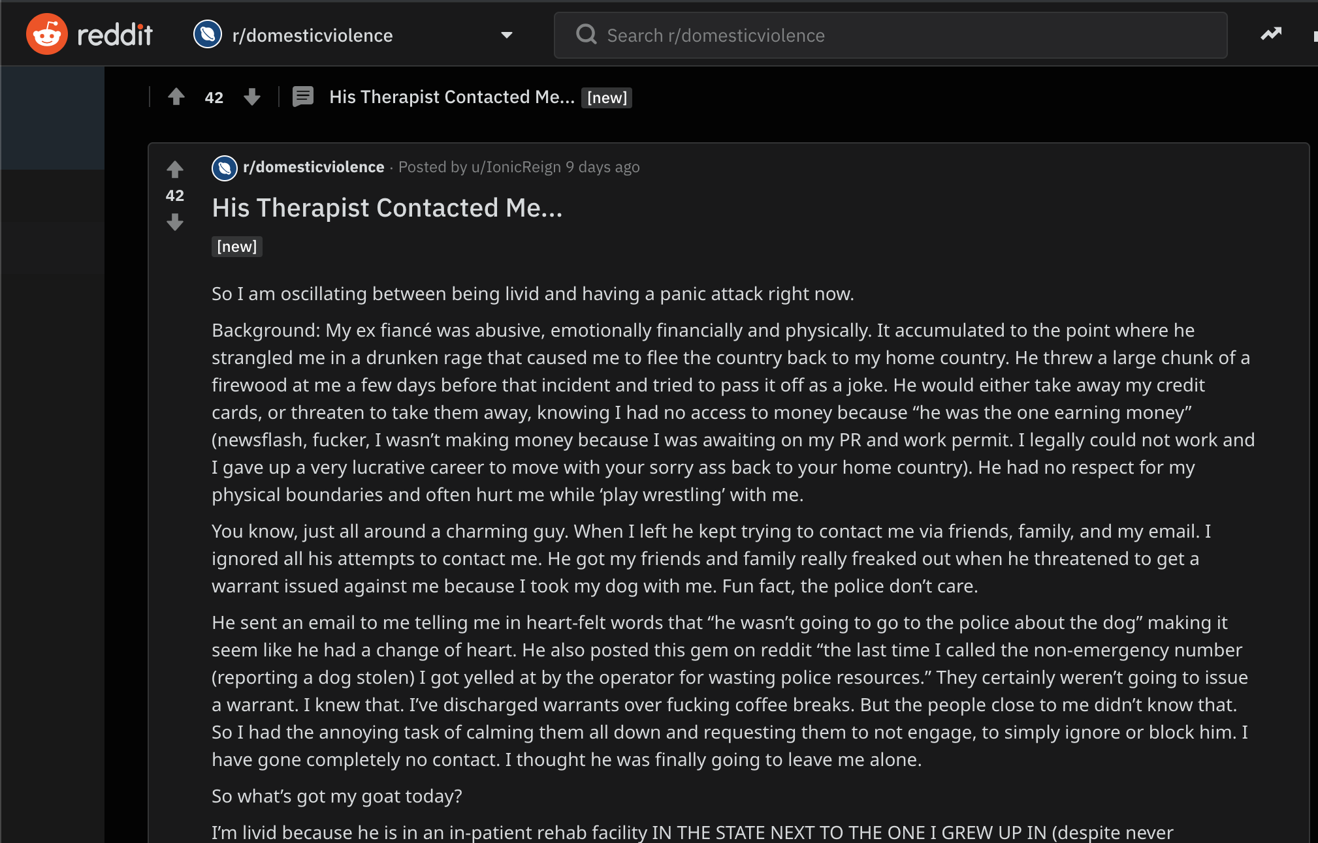

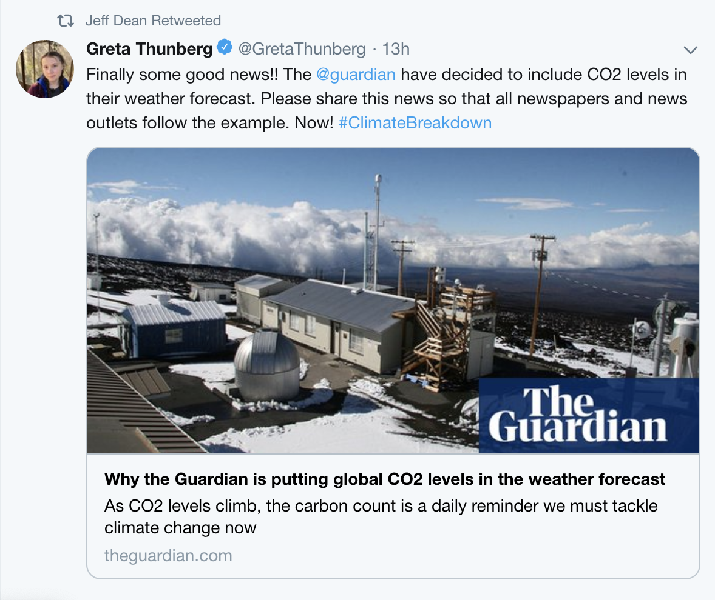
Applications of NLP
Online Social Media Analysis

Slide 6
Applications of NLP
Audio Speech Analysis
Stylometric Analysis
Fake News Analysis
Authorship Verification

Slide 7
What makes NLP challenging?
Ambiguity
Word Sense Ambiguity :
I love sitting close to the bank!
bank == riverbank or financial bank??

Slide 8
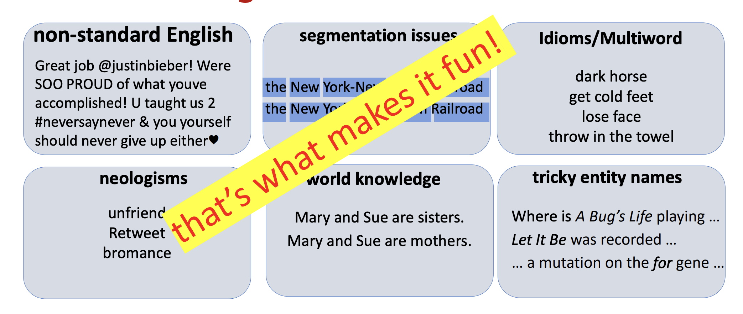
What makes NLP challenging?

Slide 9
Basic NLP Terminology

Slide 10
Tokens
Word Type
Tokenization
Words or entities in the text
Unique, non repeating tokens in the text
The process of breaking down text into tokens.

Slide 11
Machine Learning Pipeline
Preprocessing
Feature Selection
Feature Extraction
Machine Learning Task
Notes:
N-gram, BOW, count vector, tf-Idf, word embeddings, Starter projects pos tagging, HMM, Fundamental projects:
Spacy, standford
Textblob, nltk, spacy

Slide 12
Preprocessing
Normalization
Stop-word Removal
Stemming
Lemmatization

Slide 13
Normalisation
Normalisation consists of:
Lowercasing
Removing punctuations
Converting numbers into words

Slide 14
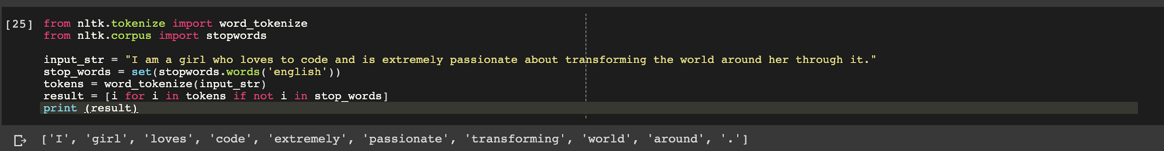
Stop-Word Removal
Words which contribute little to the overall meaning of the text.

Slide 15
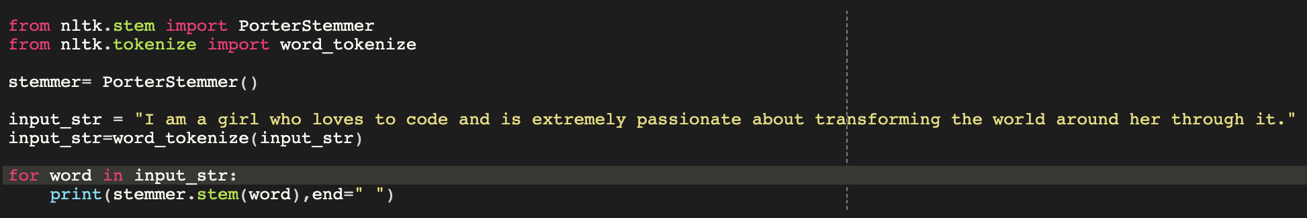

Stemming
Stemming is the process of eliminating affixes (suffixed, prefixes, infixes, circumfixes) from a word in order to obtain a word stem.

Slide 16
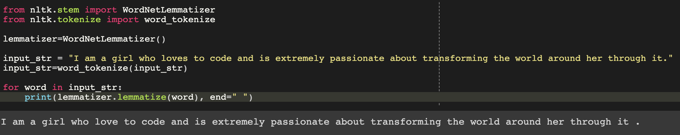
Lemmatization
Related to stemming
Able to capture canonical forms based on a word’s lemma
Eg. better -> good

Slide 17
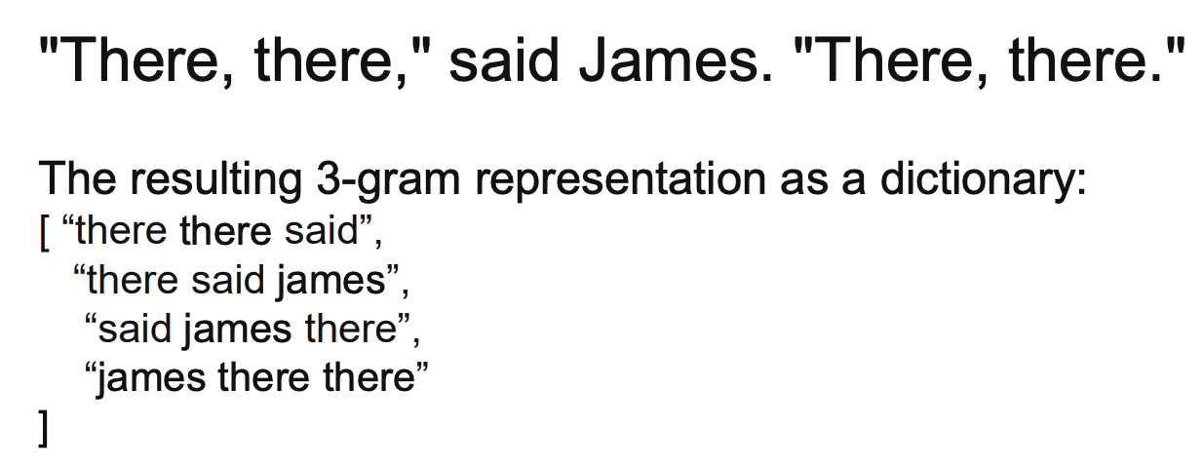
n-gram
Preserves contiguous sequences of ‘n’ items from the text

Slide 18
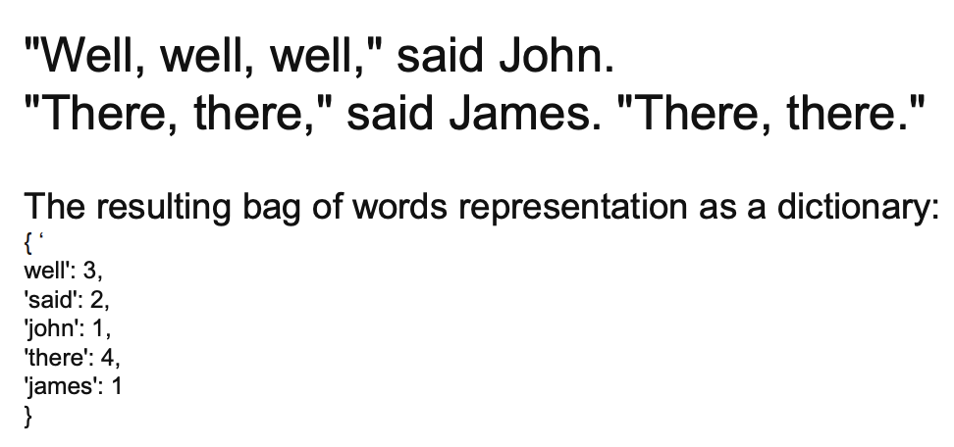
Bag of Words
Preserves number of occurence of words within the text.

Slide 19
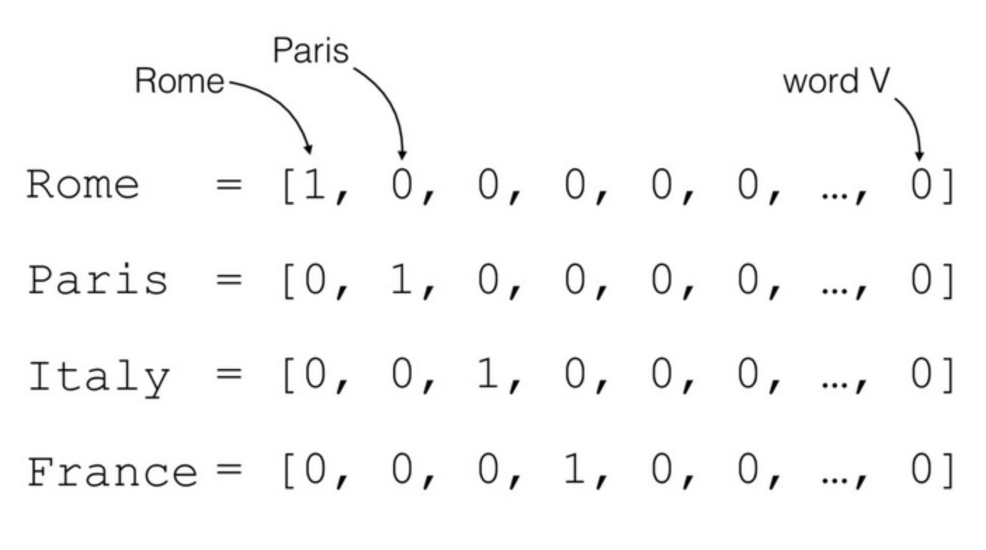
Count Vectorization
Preserves number of occurence of words within the text.

Slide 20
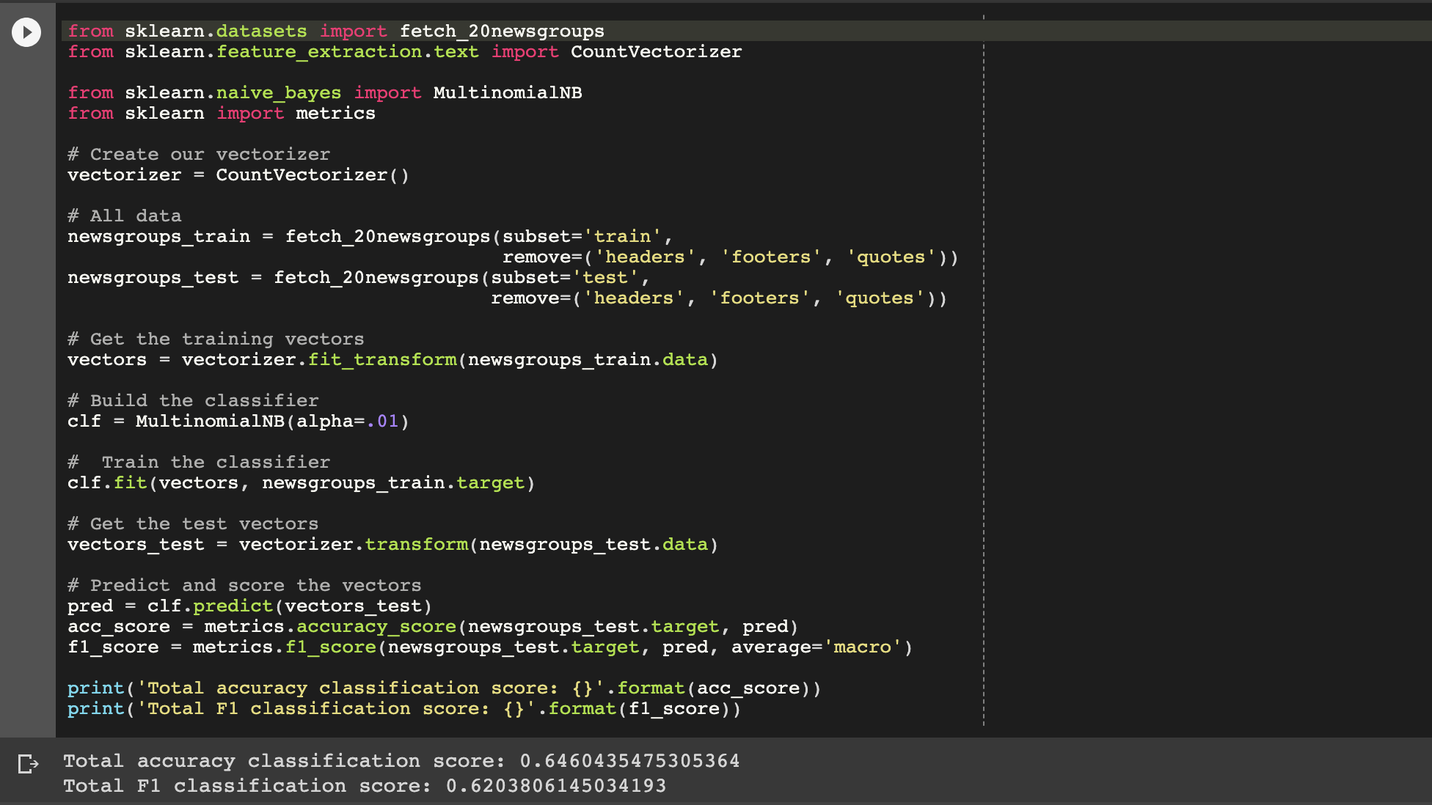
Classification using One-Hot Encoding

Slide 21
Parts-of-Speech Tagging
Named Entity Recogition
Semantic Parsing & Question Answering

Slide 22
Document Summarisation - Abstractive and Extractive
Natural Language Generation
Grammatical Checking

Slide 23
Starter Project Ideas
Sentiment Analysis
Spam Detection
Essay Scoring
Lots of competitions on Kaggle...

Slide 24
Preprocessing Example
Link:
https://colab.research.google.com/drive/1k4CKKX0K_Ue4f6_VwQnEy5Gzx8h2q9uC

Slide 25
Classification using One-Hot Encoding
Link : https://colab.research.google.com/drive/1bZH1QIzSoAweAgf9dVGMWDgOWJ78waVH

